Slide 1
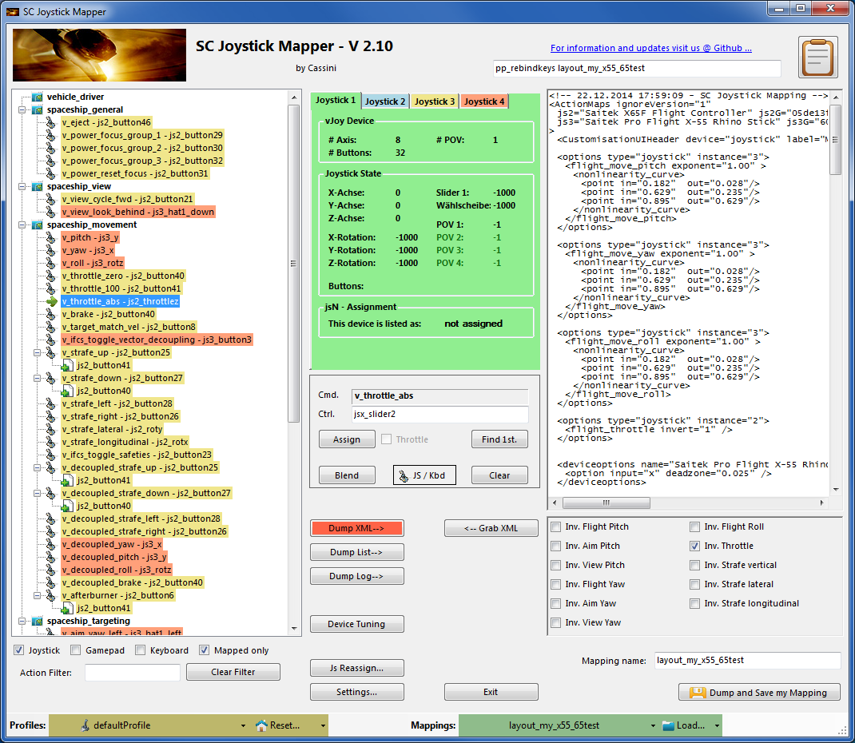
SC Joystick Mapper Quick Reference Guide V 2.10
20150104 – Cassini
ChangeLog: see ReadMe.txt
Disclaimer:
Usual stuff – no warranty whatsoever..
Freeware – made for the SC community
Hope it helps and does not suck.
Have fun in the verse …

Slide 2
Updating from V 2.x to V 2.10:
With AC 1.0 a lot has changed in mapping: old options (pilot_something) are renamed and re-ordered → copy the file and manually delete those from the map before loading. Or delete them in the XML window and then “Save” it under a new name then Load the newly created mapping file (it should no longer contain options parts)
Now you may re-create the options via Tuning and Invert checkboxes
Further cross device mappings have to be deleted as they are not supported in AC1.0 they will show up in pink or gray in the tree and must be Cleared manually Use the new sub-actions (page 29) to have multiple assignments.
If you encounter an error or crash then read on…
You will find ‘log4net.config.OFF’ in the distribution zip. Rename it to ‘log4net.config’ and run the program. Then look for a file named ‘trace.log’ in the program folder and send this to cassini@burri-web.org along with a description of the problem and your system i.e. OS, CPU, Graphics card, Joystick(s) we may then finally solve the issue …

Slide 3
Contents
Page 2 Version Upgrade and Issue Handling
Page 3 Contents (this one…)
Page 4..10 General GUI and how to’s
Page 11..14 V2.0 new features
Page 15 V2.1 new features
Page 16 V2.2 new features + V2.5 refinement
Page 17 V2.3 new features + V2.4 refinement
Page 18 V2.5 new features
Page 19 V2.7 new features
Page 24 V2.8 new features
Page 29 V2.10 new features
Last Page Common Workflows - Cheat sheet

Slide 4
Workflow (see also last page)
Connect the game control devices to the PC
Start from scratch or load an existing map from a file
Make or refine mappings
Save the new map to an XML file
Use it in the game: e.g. pp_rebindkeys C:\maps\layout_my_joystick
V 2.0: You may load and save the map directly from your game folders so next time you just use pp_rebindkeys layout_my_joystick
Note: the predefined actions are the ones found in the AC game default profile – it is likely that some of them will not work at all as the game is not finished. There is no proper description for which one does what – you may get help in SC Forums.
As I had my issues with missiles here a finding..
To reallocate the missile fire command you should map the following 2 actions to the same joystick button:
v_target_missile_lock_selected
v_weapon_launch_missile
BTW: if you copy e.g. “pp_rebindkeys C:\maps\layout_my_joystick” from notepad you may use Ctrl-V to paste it in-game into the console – saves you some typing…

Slide 5
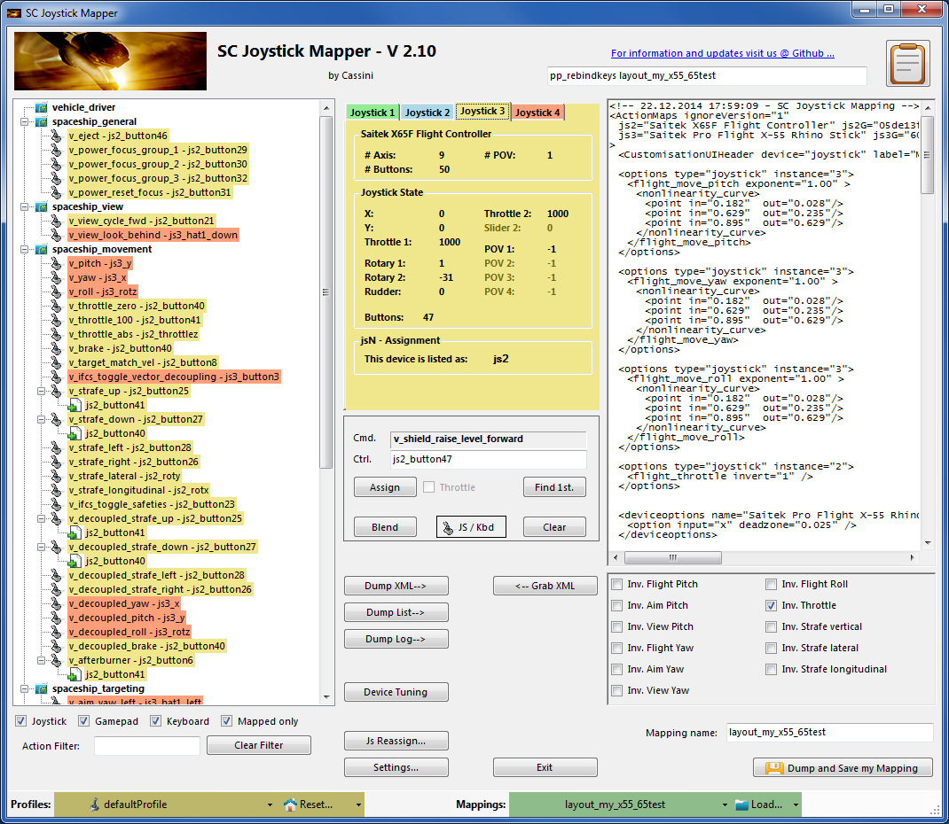
The GUI …
Action tree and mappings
XML dump of the mappings used
Detected Game devices
(up to 8 are shown)
Device properties
(greyed out ones are not available)
Joystick device map
Selected mapping
Dump nice List
Action Mapping Buttons
V2.10 Dump Controller log
XML Area Buttons
V2.3, 2.4: Js Reassignment
V2.7: Joystick Tuning
V2: filter the action tree
V2: Save into game folders
V2: Load from game folders
V2: New Reset with options
V2: Resize the window

Slide 6
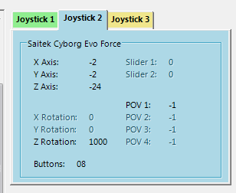
The Joystick Area…
V2.3 Update here
Here I pressed the Button 8 on the Cyborg Evo Joystick to capture the image
The tabs represent the game devices found connected to the PC also the number 1..8 shows the order the PC reports them which is crucial to the mapping as this will result in the default js_1, js_2 .. Names used to build the command name.
The elements are the ones the joystick seems to support – greyed ones are not available for this device.
V 2.4: you will see the actual Js assignment - or ‘not assigned’ – see page 17
The SC-Device to Joystick Mapping is a separate window accessed by hitting the ‘Js Reassign’ button.
Just hit any button, Axis and see how things are changing.

Slide 7
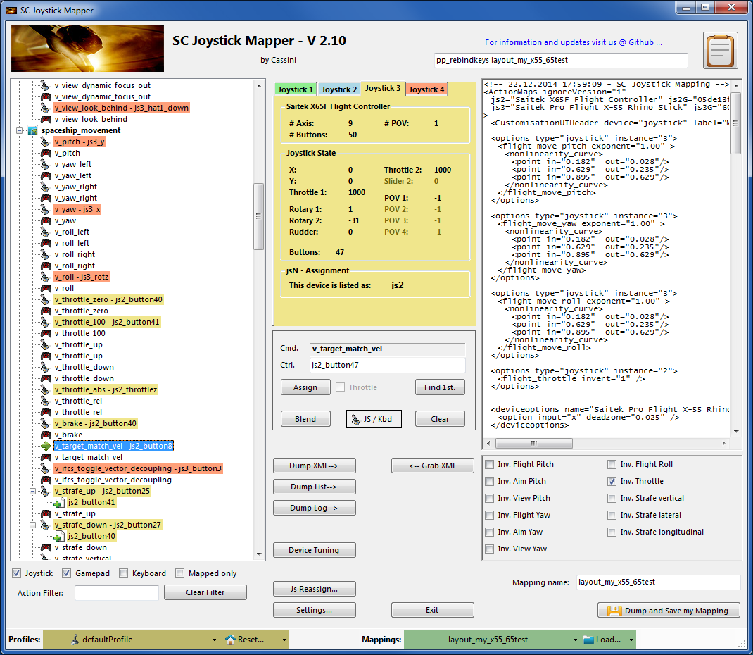
The Action Tree …
The tree is initially built from the known actions which are grouped along ‘actionmaps’ e.g. ‘spaceship_movement.
Each action is either a predefined joystick or keyboard action – this is given by the SC default profile.
By ‘rebinding’ or mapping and action with a different controls one does replace the default one i.e. overwriting keyboard actions will result in not having them available on the keyboard once you load the map in the game!
However no damage is done! This mapping is only valid until you exit the game or type pp_rebindkeys without a name
If actions are mapped (as shown) the color indicates to which joystick the mapping goes.
v_pitch – js3_y then means that the action v_pitch (joystick per default) is rebound to the joystick 3 (orange) and there the Y-axis control.
If the background is white - there is no current mapping given.
Unmapped actions are ignored.
Click on any action to make it the used action in the mapping area. Once selected it is marked with the green arrow.

Slide 8
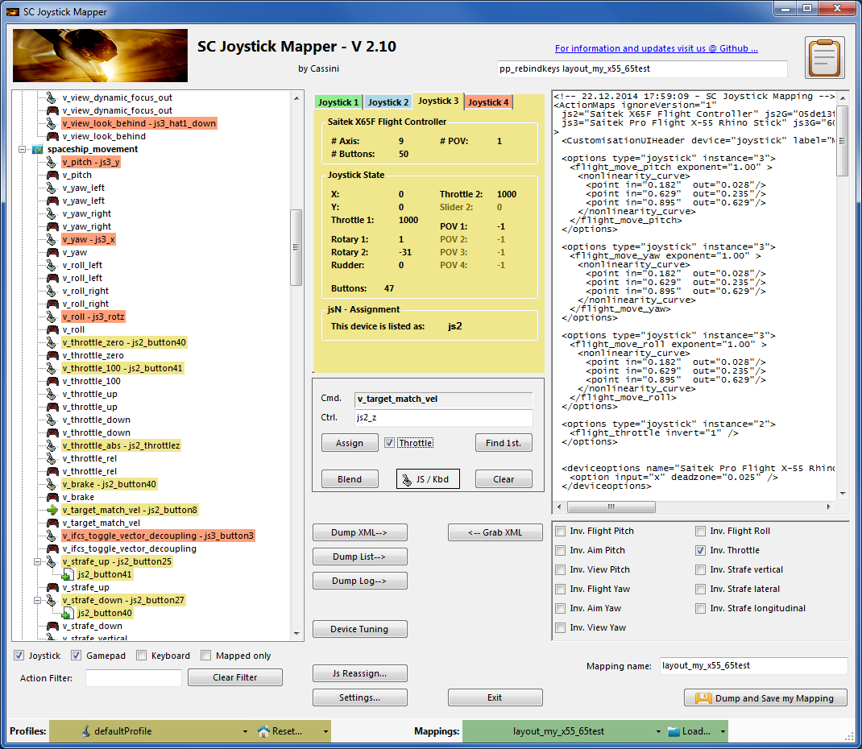
The Mapping Area…
Whenever you click on an action in the Action Tree it is copied into Cmd. and can be mapped to a Control.
The Control (Ctrl.) is the last joystick item you activated on the currently shown joystick tab.
I.e. if you want to map it for a control on the second joystick you have to select the “Joystick 2” Tab first.
Once you have a mapping that should be used, hit the “Assign” button.
The new mapping will be shown in the Action Tree – where it gets the back color of the joystick it is assigned to.
V2: To make any axis a Throttle axis – check the ‘Throttle’ box ! It is often the Z-Axis but the Rhino has it e.g. on js2_y.
If you do so the control assigned in changed to a throttle control (here js2_throttlez)
To clear a mapping – select it in the ActionTree and Click “Clear” - it gets a neutral color and no control in the ActionTree – it is now unmapped.
You may use “Find 1st” to find the first action where the currently shown Ctrl. (js2_z or if checked as shown js2_throttlez) is mapped.

Slide 9
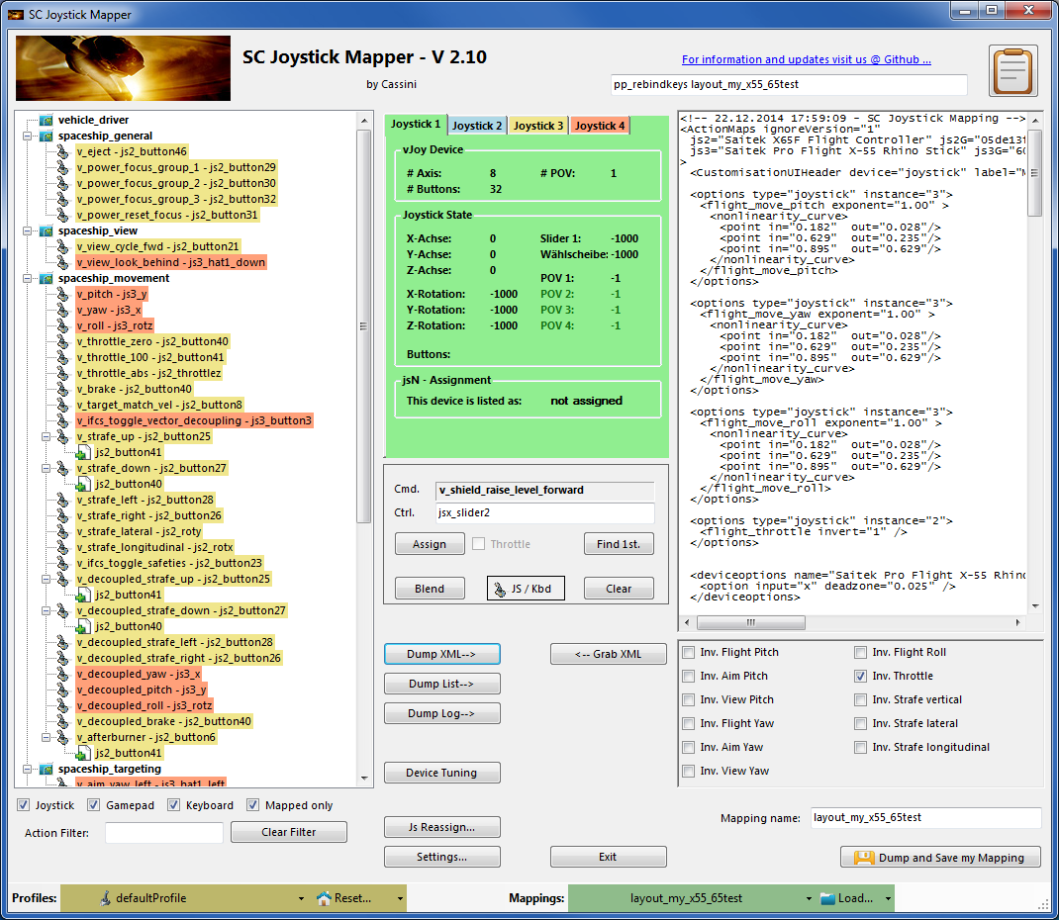
The XML Area…
Mappings are sent to the game using XML formatted files.
The XML Area is where you may find the mapping after hitting the ‘Dump’ button.
Rightclick opens a menu where you may choose from:
Copy, Paste, PasteAll, Select All, Open…, Save As…
The usage is rather common here. Once you dumped the mapping you want to “Save” it as “filename.xml” somewhere.
To refine any mapping “Open” the file – the content is shown in the XML Area, then “Grab” it into the ActionTree.
Once the refinement is finished – again Save it to a file.
Load and Save much easier … read V2 Feature pages
Note: only use properly formatted ActionMaps here. The program may just break if it encounters something unexpected!

Slide 10
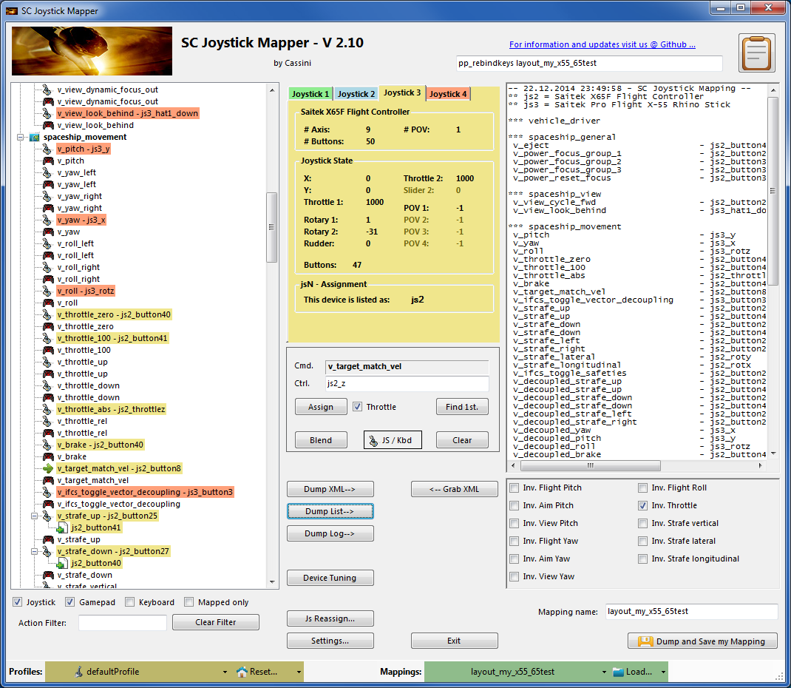
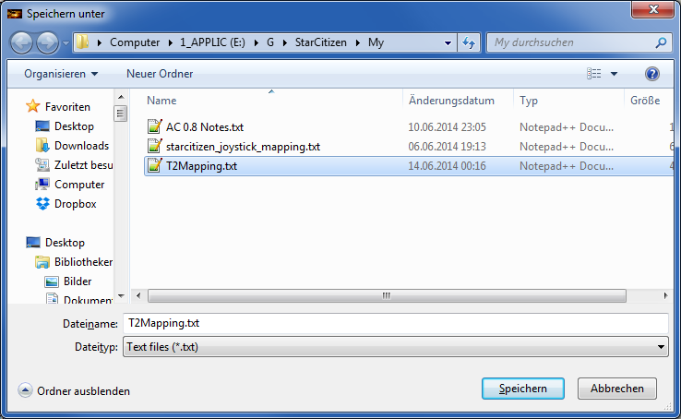
The XML Area…
If you hit “Dump List” a formatted list of the mapped actions is written into the XML area.
You may use the “Save As..” menu to save it e.g. as TXT file.

Slide 11
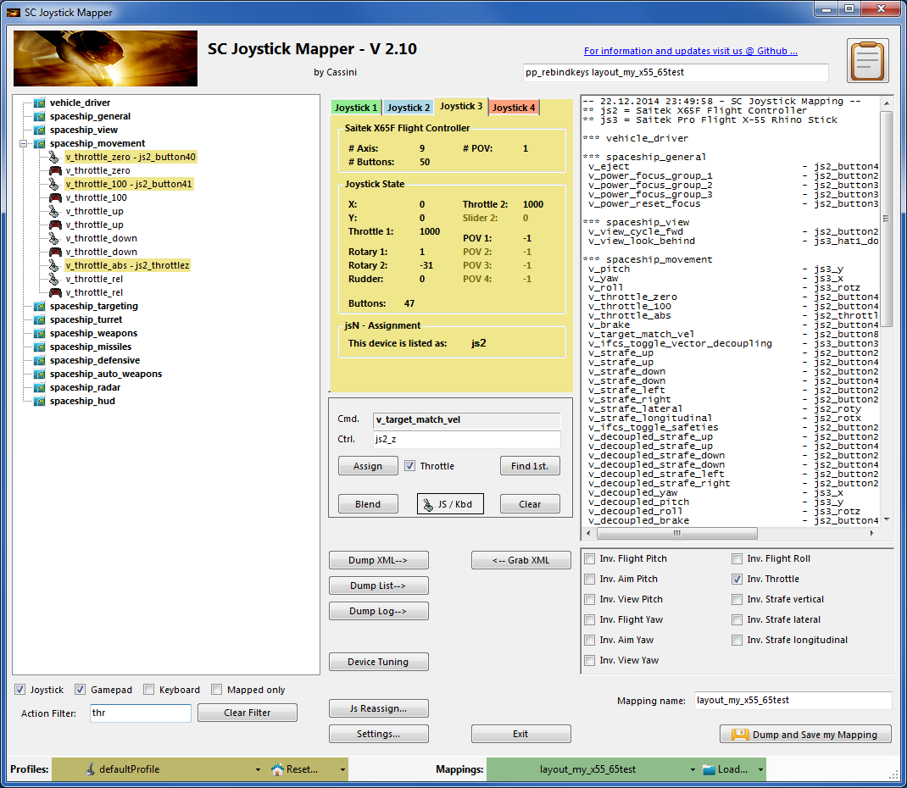
V2 – Features - 1
You may filter the action tree now
Start typing and the tree is reduced to the actions and controls that contain the characters typed
e.g. I typed ‘thr’ to see my throttles only
Try button and you get all your assigned buttons only etc.
Click ‘Clear Filter’ to get back to the complete list again.
Note: this will not change, remove or modify any of your mappings, it just reduces the tree to the ones you are interested in.

Slide 12
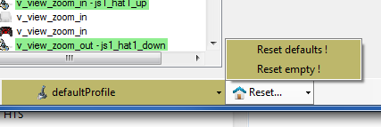
V2 – Features - 2
New working with profiles.
The program gets the actions from the real game asset – so you are always up to the actual values.
From here you may Reset the action list to the following
RESET EMPTY reverts to just an action list without any mappings
RESET DEFAULTS loads the Joystick actions mapped with what CIG is providing
Note: as CIG is providing a number of defaultProfiles you may chose one of those – however using the defaultProfile is usually the best option (This may be work in progress by CIG…)

Slide 13
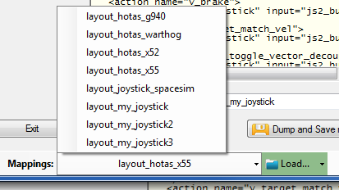
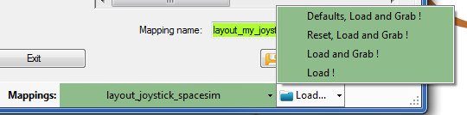
V2 – Features - 3
New working with actionmaps (Maps, Mapping etc..)
The program gets the actionsmaps from the real game asset – so you are always up to the actual values.
(…\StarCitizen\CitizenClient\Data\Controls\Mappings)
From here you may first chose a map, then ‘Load’ the actionmap – this will overwrite you XML window in any case
LOAD loads the map into the XML window only
LOAD and GRAB loads the map into the XML window and clicks Grab i.e. merges the existing mapping with the one loaded
RESET, LOAD and GRAB first Reset (empty) the action list (all mappings cleared) then it loads and grabs the new map
DEFAULT, LOAD and GRAB first Reset (defaults) the action list then it loads and grabs the new map and merges them with the defaults
See last page for some common workflows
And how to handle them easily

Slide 14
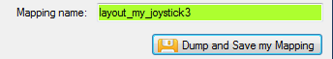
V2 – Features - 4
New working with your own actionmaps
The program not only gets the actionsmaps from the real game asset – but also can save your maps there.
(…\StarCitizen\CitizenClient\Data\Controls\Mappings)
Type a name (limitations see note)
Hit the button – it will then Dump and Save your map into the game folder (well asking you to overwrite it if it exists)
NOTE: your map name has always to start with ‘layout_my_’ to prevent modifying CIGs own actionmaps
Lowercase only, no spaces, tabs allowed else you see the red flag ..
A successful Save will show the green flag
Your own maps will then show up like the game provided maps
pp_rebindkeys layout_my_joystick should load it into the game
Note: For your convenience each Save also makes a copy of into your personal
“My Documents\SCJMapper” folder – no work is lost if there is an update
that cleans the Mappings folder.
2.0

Slide 15
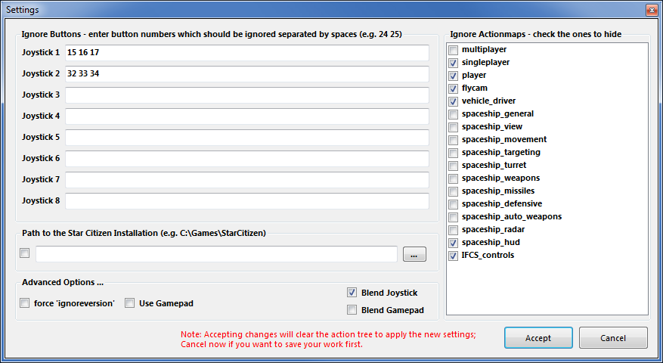
V2.1 – Features
V2.8 Update here
New possibility to blend the unmapped joystick entries V2.8 is now in Settings
If you wish to hide all the joystick actions that you don’t use – to make sure they are not active – check “Blend Joystick” and/or “Blend Gamepad”
The program will then map all unmapped actions with ‘jsx_reserved’ or ‘xi_reserved’ preventing any profile settings on the joystick.
This is fully reversible – just uncheck the option and Dump the contents again.
See also V2.8 new features on how to blend single items
New Settings window
As many are concerned about steady ON buttons that might interfere with assigning the proper control to an action we included a setting to IGNORE specific buttons. Just enter the button numbers to ignore separated by a Space.
Make sure you enter the numbers for the right Joystick.
Numbers are the same as in the main window.
There is also way to override the programs own detection of the Star Citizen install folder.
Make sure to use the Checkbox if you want to override!

Slide 16
V2.2, 2.5 – Features
New possibility to ignore unwanted actionmaps
If you wish to ignore some maps to unclutter the GUI
If you with to use the default ignored new actionmaps multiplayer, singleplayer, player
The program will ignore all actionmaps that are checked
In the example multiplayer, singleplayer, player and IFCS_controls are completely ignored and will not show up.
Just uncheck any to use it again.
V2.5 New option to force ‘ignoreversion=“1”’
If you wish to use the ignoreversion attribute rather
than any version=“n” ..
The prog is able to handle it now. Either type e.g.
‘version=“0”’ or ‘ignoreversion=“1”’
Into the ActionMaps Tag and the prog will maintain
it as you typed it.
Or just force it to use ‘ignoreversion=“1”’
by checking the box here
2.0

Slide 17
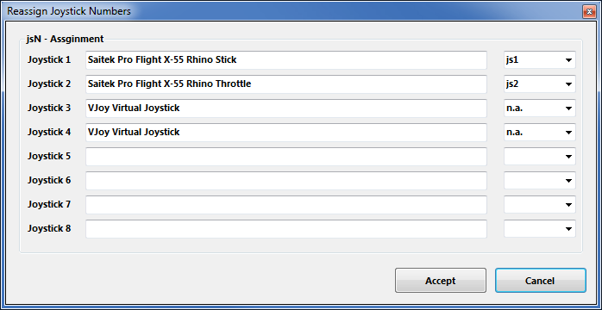
V2.3, 2.4 – Features
New possibility to (re) assign the joystick devices to the wanted js - number
Go here if you wish to assign a device to a particular js – number or to re-assign the devices to other numbers.
Per default the devices found are assigned along the sequence 1..8 but SC may remap them so here is the place to fix this without having to go through all commands and reassign them.
Notes: The color of the assigned items will not change as it is still the same device but js1 will become js2 for example.
You can leave this dialog with “Accept” only if each device is either assigned to a unique number or to n.a. (not assigned) otherwise an error pops to ask you to fix it or Cancel.
V2.4 allows to assign js1 .. Js8 now
Related SC console commands are:
i_DumpDeviceInformation
pp_ResortDevices joystick 1 2
pp_rebindkeys export joystick
pp_rebindkeys export xboxpad
2.0

Slide 18
V2.5 – Features
New possibility – support for options
The prog will now maintain the following 3 XML tags
<CustomisationUIHeader …>
<options …>
<deviceoptions …>
See 2.7: for more new option handling
You may copy and paste or type whatever of those 3 tags you want to use – the program will maintain your typing and also read it from the mapping file when it is already there.
Note: There is no support to get proper options or let you interactively design those tags (sorry I know too little about all useful possibilities)
The program stores the tags as plain string and will not do anything but get them in and out again. Some pretty printing is applied.
Hint:
copy and just paste them into the editor – easy
Or load your modified mapping – the prog should maintain them
(testing by looking into the file the first time would be sensible…)

Slide 19
V2.7 – Features - 1
New possibility – Device Tuning Window
The prog will now maintain the following 2 XML tags
<options …>
<deviceoptions …>
To get the Options done – click the “Joystick Tuning” button.
A Window opens – will be shown on the next page.
It supports:
Deadzone, Sensitivity, Invert, either Exponent or NonLinearCurve independently for all 3- Yaw, Pitch, Roll axes.
Options saved with SCJMapper will be read and applied, due to the various option formats however it may not be able to just read any options out there.
Note: Best start the first time with a mapping without options !!
V2.8 supports also Gamepads

Slide 20
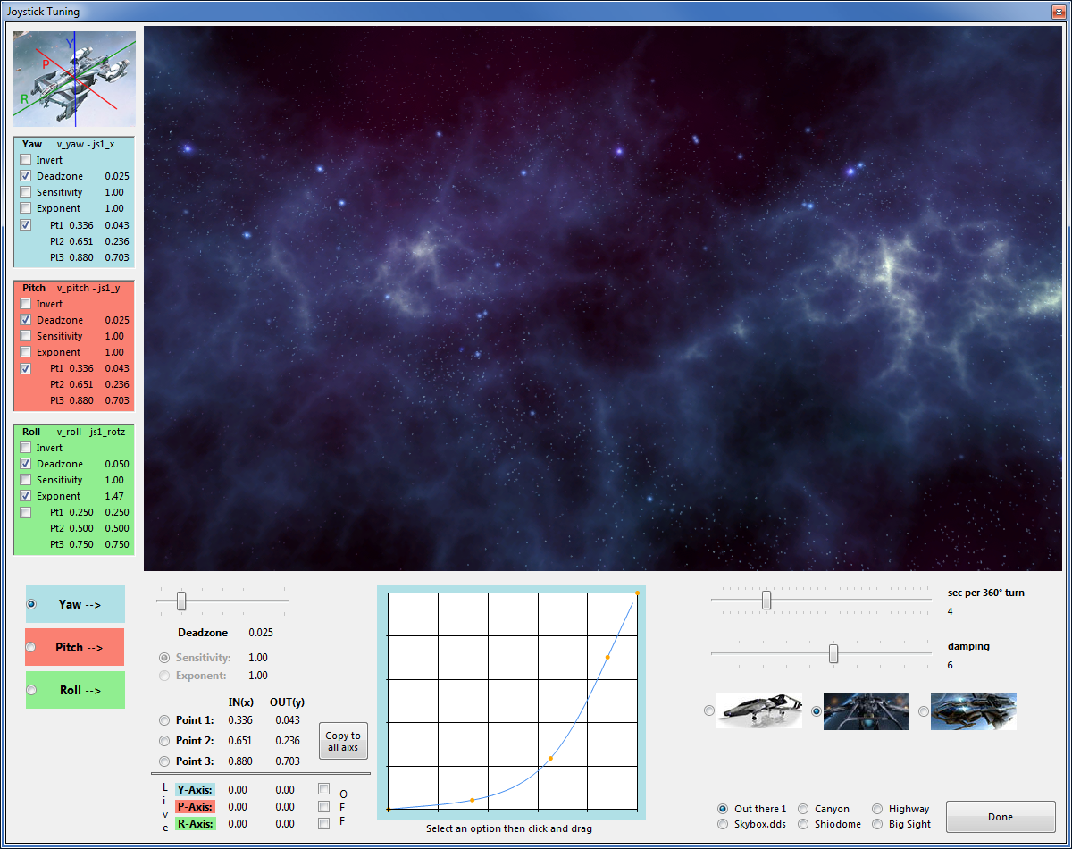
V2.7 – Features - 2
Actual mapping for the axis
Live View of the joystick movement
Tuning parameters of the axis
Tuning parameters of the active axis
Turnspeed [seconds per full turn]
Joystick IN-> OUT map
Activate an axis
Damping - how fast will a movement stop (1=fast)
Speed/Damping Presets –
Estimates, guesses…
Live IN – OUT values scaled 0 .. 1
Changing Skies
Finish

Slide 21

V2.7 – Features - 3
How to…
There is one active axis – the color frame of the chart indicates the active one (here blue = Yaw)
Parameters can be manipulated for the active axis only.
Switch the active one by clicking the Yaw, Pitch, Roll Option (bottom, left)
Activating a tuning parameter will activate too
Parameters must be ‘checked’ to be used
e.g. Deadzone and NonLinearCurve (Pt1..3) are checked for Yaw
Each axis has it’s own set of parameters
Active and Checked (Enabled) parameters can be changed.
Deadzone is a simple slider from 0.0 to 0.15 (try it out in the live view)
All other parameters are handled by first choosing it (e.g. Point 1)
Changing the value by first left click and hold into the chart area, then moving the mouse up-down and left-right to adjust – then release the mouse button.
Point 1 is usually the leftmost orange marker
If you wish to copy the Curve Points to all other axis – click the Copy button
Sensitivity and Exponent will only go with up-down movement of the mouse
1
2
3
3
3
3
4
5
6
2
6
4
1
5

Slide 22

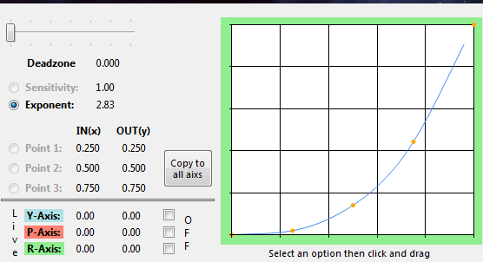
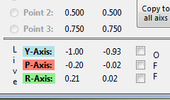
V2.7 – Features - 4
…
Here Roll (Green) is active and Exponent is chosen to be changed.
By click, hold and moving down – the exponent was changed from 1.47 to 2.83
The curve represents IN vs OUT of the joystick
If you move the joystick the ‘Live’ fields will report what’s going on:
Sometimes it is helpful to just disable one direction of the movement
Check OFF for any axis (it just disables it for the Live View)
1
2
3
1
1
2
3

Slide 23
V2.7 – Features - 5
Once back from Tuning…
With “Dump” or “Dump and Save” you will get the new Tuning values into the XML area – if you don’t want to apply the new settings, just hit “Grab” to restart with the settings from the XML area.
With “Dump” the prog will maintain the parameters using the following 2 XML tags
<options …>
<deviceoptions …> (Deadzone only)
One set for each axis
Note: the program will automatically apply Exponent=“1” if the Exponent is not used – if not set to 1 the game will use something like 2.3 and reshape any setting to an unexpected outcome…
If you have a 2 monitor setup – you may want to try to have the tuning window open while running AC – the joystick input is then applied to both applications – getting into the console will let you the mouse to interact with the tuning window, create a new tuned map and you may apply it immediately via console rebind to try it out
(You may need a fast computer – but then AC needs this anyhow…)

Slide 24
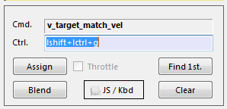
V2.8 – Features - 1
New possibility – Use Keyboard assignments
The prog will now recognize keyboard assignments.
Switch to Keyboard mode by pressing the JS/Kbd Button
-> the Icon changes to a Key and the Ctrl. Field gets lavender color.
Note: keyboard entries are accepted when the Ctrl. Field has the focus
Now you may press any key or key+modifier until it fits the need.
Then hit ‘Assign’ to map the command as usual.
To get back to Game Control input – hit the JS/Kbd button and the entry mode gets back.

Slide 25
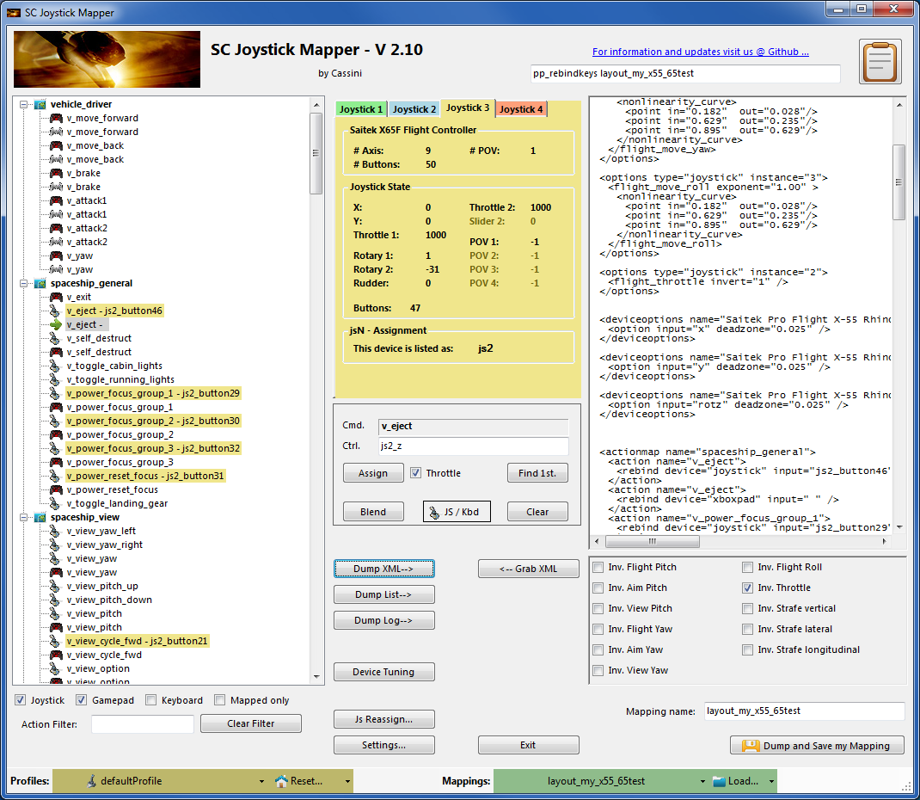
V2.8 – Features - 2
New possibility – Blend single items
If you wish to blend a single item from the defaultProfile i.e. hide it from use select an item and then hit the ‘Blend’ button.
The items gets a dash but no command; “v_eject – “ in the example.
Once you dump it will be mapped with a <Space>
To unblend – ‘Clear’ the item
To blend all joystick or gamepad commands go to Settings and check the corresponding checkbox – see also page 15

Slide 26
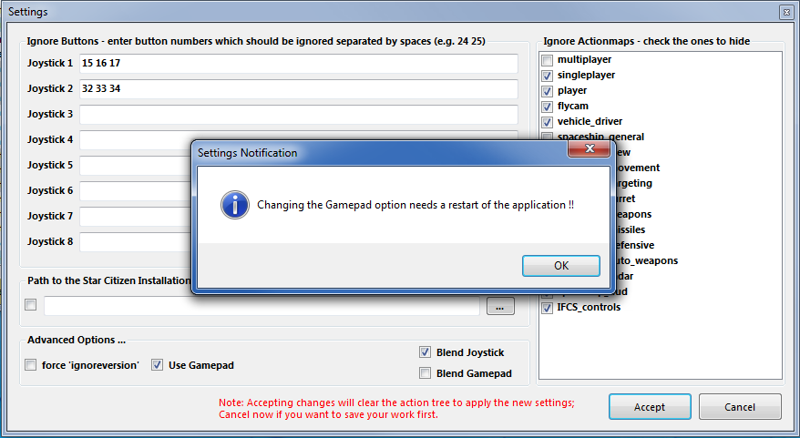
V2.8 – Features - 3
New feature – Use Gamepad assignments
The prog will now recognize gamepad assignments.
To enable the use of gamepads as “xboxpad” go to ‘Settings’ and check the ‘Use Gamepad’ checkbox.
THIS IS DISABLED per default to maintain backwards compatibility.
Note: now you have to restart the program
See next page how this then looks like

Slide 27
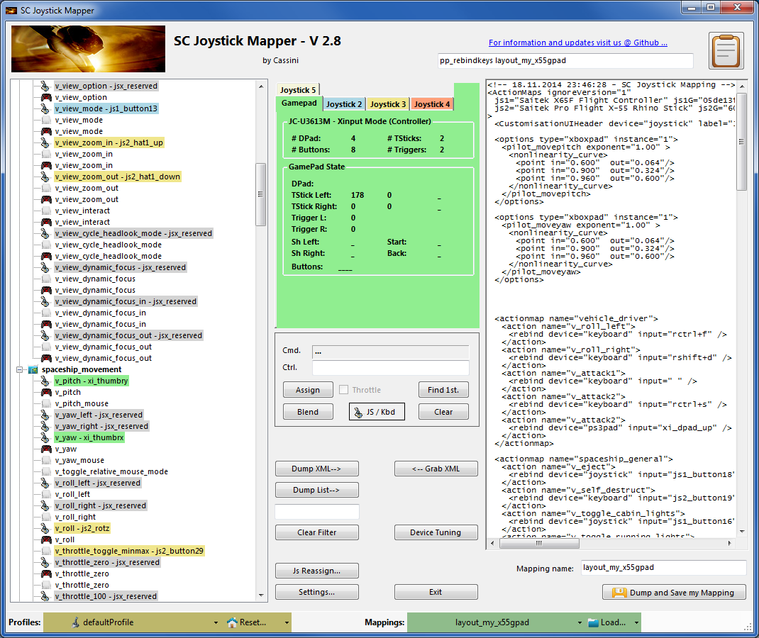
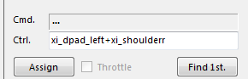
V2.8 – Features - 4
New possibility – Use Gamepad assignments
You see the Tab has changed to ‘Gamepad’ and the standard properties of the “xboxpad” instead of generic ones are listed.
From here it is the same handling as with joysticks
You may also use combined commands here.
Note: sometimes your command is not recognized with the first try
-> Check the Ctrl field each time and if it does not yet capture what you want – try once more.
Also releasing the controls together helps to get successful Ctrl. Entries.
You may also go to Device Tuning and apply all mods that are available there
- Only Yaw and Pitch commands on the left or right X and Y thumbs are supported for tuning!!

Slide 28
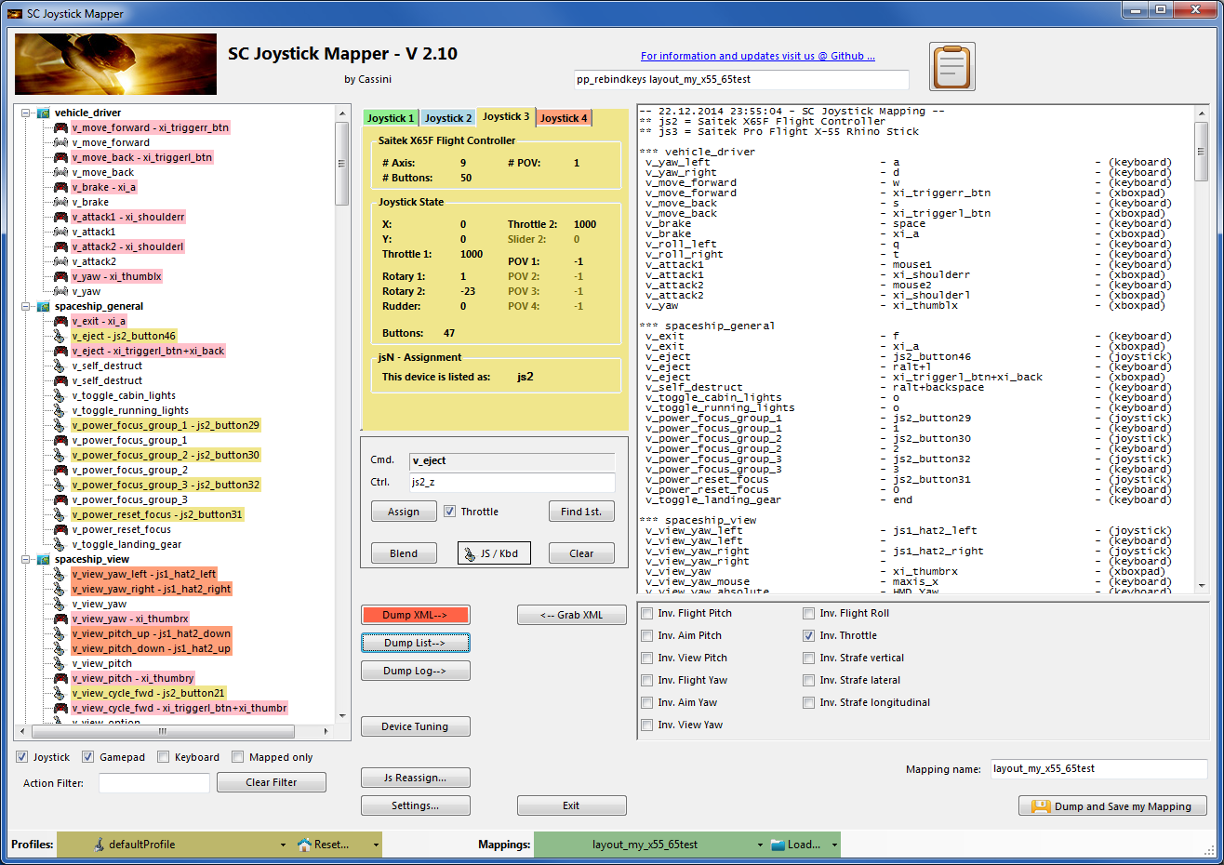
V2.8 – Hints…
How to get a list of all commands ??
Load a map using Defaults – see mark above
Hit ‘Dump List’ – and Copy / Paste or Save As..
Gets you the complete list of commands in use if you load that map.
Clicking the Notepad icon top right copies the pp_rebindkeys command into the Clipboard – from there just Ctrl-V it into the AC console..

Slide 29
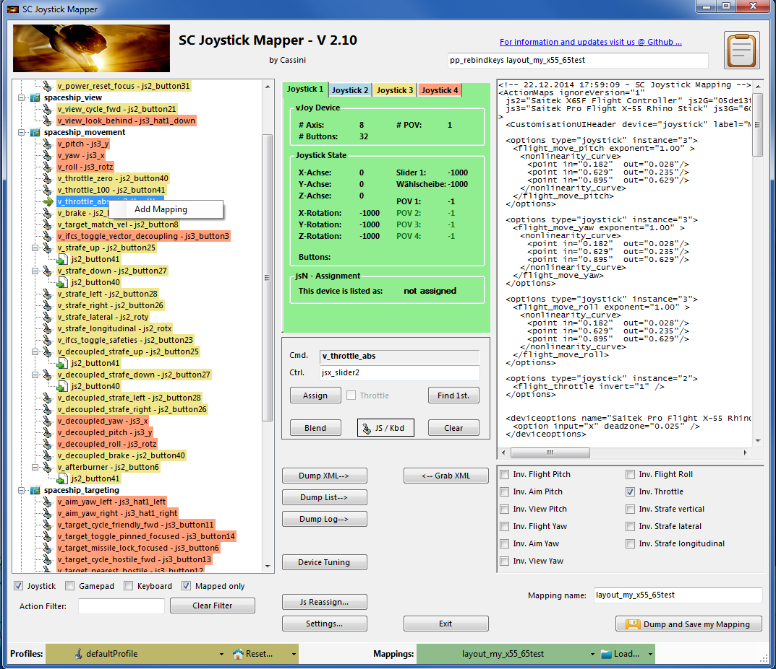
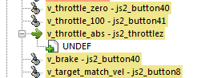
V2.10 – Features - 1
New possibility – Add sub-actions to an action
With AC 1.0 one cannot longer bind cross device i.e. you can only assign joystick command to joystick actions – and not to keyboard actions etc.
To get a second command assigned to an action one has to use ‘addbind’ in XML and with SCJMapper this works through sub-actions.
Rightclick – here it is v_throttle_abs - to get
the ‘Add Mapping’ menu and click it
You get a new UNDEF sub-action.
You can now assign a command to this one
Right click such a sub-action gets you a “Delete Mapping” menu which allows to delete such sub-action if no longer needed.
You will also find Assign, Blend, Clear as context menu if those commands are available
NOTE: Rightclick selects the item as current one

Slide 30
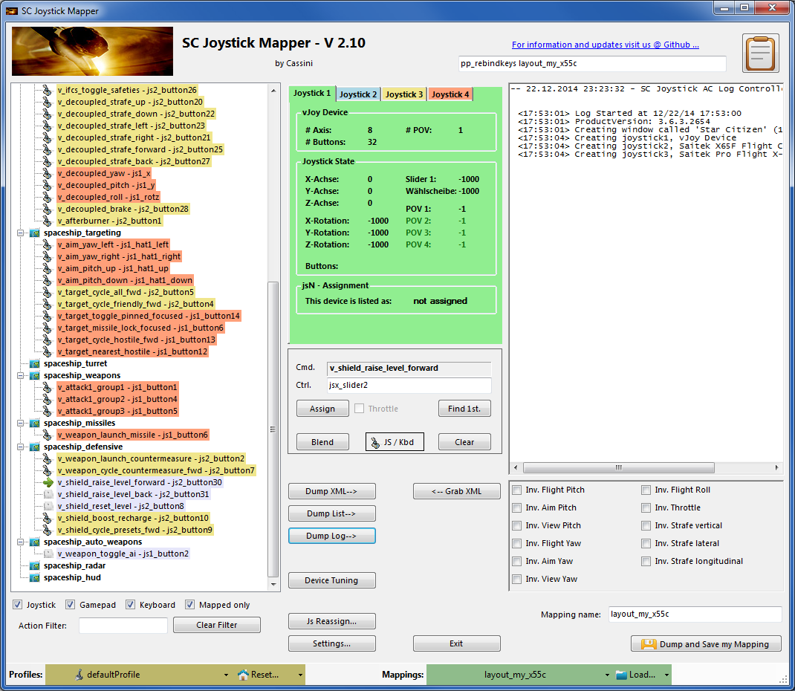
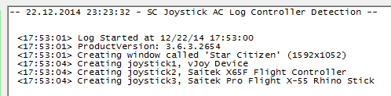
V2.10 – Features - 2
New possibility – Get the most recent Controller Mapping
To get the most recent controller mapping used by AC – click “Dump Log”
It will read from the game log file and extract as shown to the right.
Here it means that the device
‘vJoy Device’ is joystick1 aka js1 - that is the green one above
‘Saitek X65F …’ is joystick2 aka js2
‘Saitek Pro …’ is joystick3 aka js3
Now use Js Reassign to get them aligned with AC

Slide 31
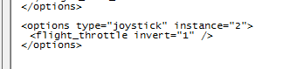
V2.10 – Features - 3
New possibility – Invert commands
With AC 1.0 one cannot longer Invert each command individually but one can only use the options XML for this purpose.
Just check the desired Inversion and then Dump XML
This will create an entry similar to the one below
Note: When I tried – all worked but the throttle one did not … (may be an AC1.0 issue)

Slide 32
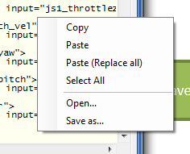
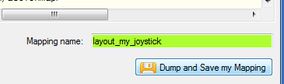
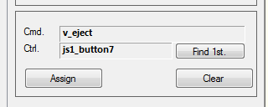
SCJMapper V 2 – Common Workflows
A
Start from ..
Do Reset or Load
Make it _my_ map
B
A
D
Empty
Reset empty !
Name _my_map
Dump and Save
A
D
C
CIG Defaults
Reset defaults !
Name _my_map
Dump and Save
D
B
D
E
D
Existing CIG map
Chose CIG map
Defaults, Load and Grab
Name _my_map
Dump and Save
Assign Ctrls
Dump and Save
B
D
Existing _my_ map
Chose _my_ map
Reset, Load and Grab !
Name _my_map
Dump and Save
E
Create a new version
A
D
Existing _other_ map
Reset empty !
Context Menu: Open… other map
Click Grab
Name _my_ map
Dump and Save
C
Create a new version

